Slide 1

Model Building Process

Slide 2
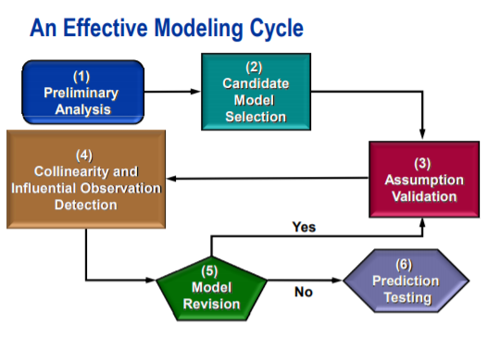
Model Building Process

Slide 3
Model Building Process
Preliminary Analysis: This step includes the use of descriptive statistics, graphs and correlation analysis.
Candidate Model Selection: This step includes model selection techniques like all possible regression using Cp, Adjusted R-square, R-square and Automatic selection methods like Forward Selection, Backward Elimination and Stepwise Regression.
Assumption Validation: This includes the plots of residuals and graphs of residuals versus predicted values. It also includes the test of equal variance.
Collinearity and Influential Observation Analysis: The former includes the use of VIF to detect the collinearity among the variables and the later includes the analysis of influential data points using different influential statistics.
Model Revision: If steps 3 and 4 indicate the model revision, generate a new model by returning to these two steps.
Prediction Testing: If possible, validate the model by using data not used to build the model.

Slide 4
Q&A

